Slide 1
PREDICTED PRICE FOR USED CAR

Slide 2



Team
Aravind Reddy M.
(00771169)
Susmitha Gopavarapu
(00760160)
Praveena Silmala
(00770123)

Slide 3
BACKGROUND:
According to study conducted by Indian Blue Book, in FY20 the used car market in India stand point at 4.2 million units. It also claimed that used car sales increased by 5% YoY within the in the same fiscal, while the new car sales contracted by 17.8%, due to the pre-pandemic depression. The used car sale were actually 50% above the amount of latest car sales recorded at 2.8 million units.

Slide 4
CRISP-DM
Business Understanding
Data Understanding
Deployment
Evaluation
Data Preparation
Modelling

Slide 5
Problem:
Frankly, 90% of people are with confession that They don’t know the exact price of car to sell .
Predictive price of used car in india

Slide 6
Attributes Required:
Name
Rating
City
Kilometres Travelled
Year of purchase
Owner
Fuel type
Transmission
RT0
Insurance
Insurance Type

Slide 7
There are various websites providing information about buy or sell price in India:
Carwala.com
Caardekho.com
Cartrade.com
Car24.com

Slide 8
Data Collection:
Raw Data Cleaning:
Data Base
Car24.com
Using Pandas
Python+ Selenium
Data Base
Data Base

Slide 9
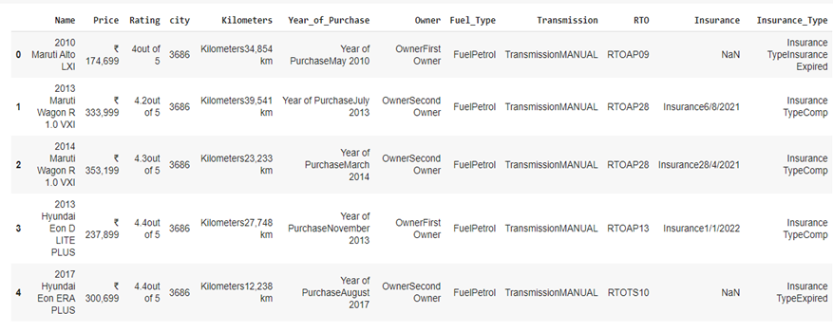

Before raw data cleaning
After raw data cleaning

Slide 10
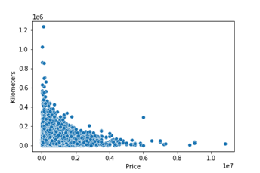
EDA
y=Kilometres
X=Price

Slide 11
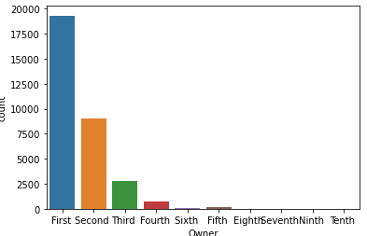
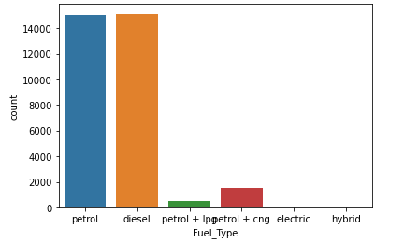
Owner:
Fuel

Slide 12
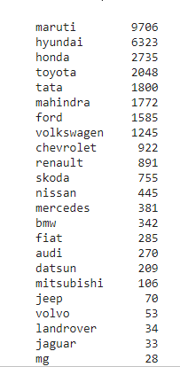
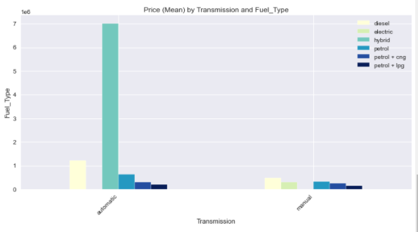
Brand
Transmission Type

Slide 13
Data Wrangling
Transformation
Scaling
Encoding
Train Test Spilt

Slide 14
Feature Engineering:
Data Pre-processing:
Missing Values
Outliers

Slide 15
Missing values:
1.Transmission
2.Insurance
3.kilometres
4.type of insurance
Methods of Imputation:
Hot Deck Imputation(D&NR) –Random and deterministic
Simple imputer-
Iterative Imputer.
4. Data wig

Slide 16
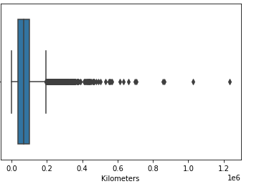
Detecting Outliners:
Attributes
Boxplot
Inter quartile range
Isolation Forest
z score
Scatter plots
Kilometres
Treatment Outliners
Rectify
Remove
Censoring-winsorization , capping

Slide 17
Skewness
Kurtosis
Price 4.516217
Rating -2.365610
city 0.219366 Kilometres= 2.291942
year -0.881832
month 0.205750
Price 44.777339
Rating 9.710756
city -0.954903 Kilometres=20.003382
year 1.381351
month -1.2903557

Slide 18
Transformation:
logarithmic Transformation
df[i]=np.log(data[i]+1)
Square root Transformation
df[i]=df[i]**(1/2)
df[i].hist()
Reciprocal Transformation
df[i]=1/(df[i]+1)
Exponential Transform
df[i]=df[i]**(1/5)
Attributes:
Price
Rating

Slide 19

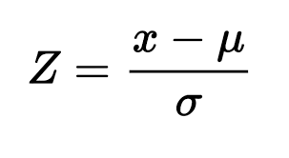
Scaling:
Normalisation:
Standardization

Slide 20
Train-Test Spilt:
Splitting the records into 80 % of the data into training and 20% of the data into Test
Encoding:
Label Encoder
Dummy Variable

Slide 21
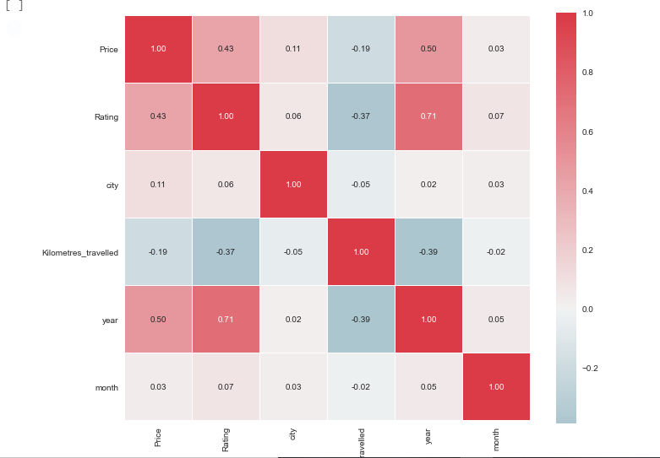
Feature Importance:

Slide 22
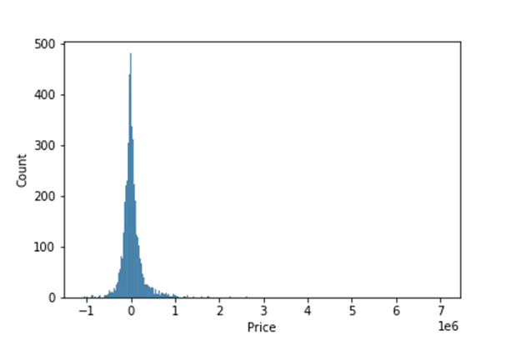
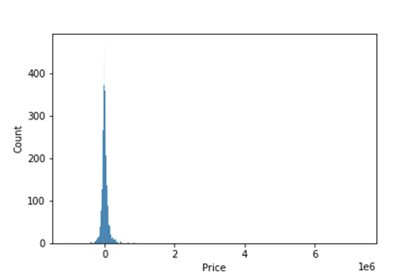
Modelling:
Multiple linear Regression:
Random Forest
R2:Train:0.719
Test:0.727
R2:Train:0.987
Test:0.916

Slide 23
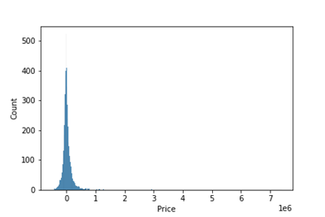
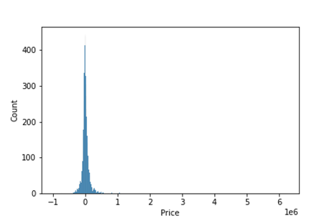
Gradient Boosting
Light Gradient Boosting
R2:Train:0.987
Test:0.916
R2:Train:0.923
Test:0.915

Slide 24
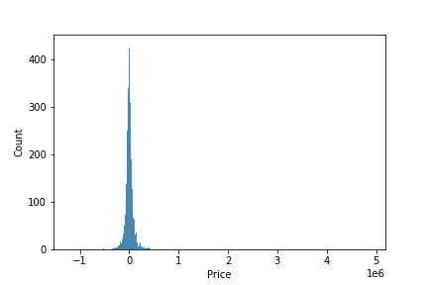
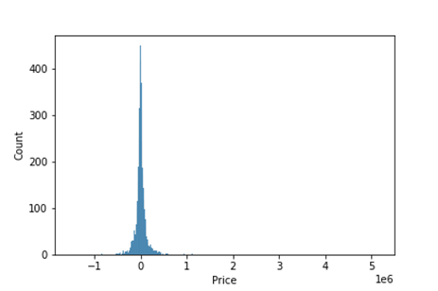
Extreme Gradient Boosting
Cat Boost
R2:Train:0.980
Test:0.944
R2:Train:0.948
Test:0.922

Slide 25
Algorthim | Train R2 | Test R2
Multiple linear | 0.719 | 0.727
Gradient Boosting Machine | 0.987 | 0.916
Light Gradient Boosting | 0.923 | 0.925
Extreme Gradient Boosting | 0.980 | 0.944
Random Forest | 0.987 | 0.916
Cat Boost | 0.948 | 0.922

Slide 26
Thank you

